Slide 1
Fundamentals of Business Statistics
Hypothesis Testing
Dr. P.K.Viswanathan

Slide 2
Preliminaries
P.K.Viswanathan

Slide 3
Sampling Distribution-A Conceptual Framework
The probability distribution of all the possible values a sample statistic can take is called the sampling distribution. of the statistic. The key word here is “sample statistic”.
Sample mean and sample proportion based on a random sample are examples of sample statistic(s).
P.K.Viswanathan

Slide 4
Concept of Standard Error
What is the standard deviation of the sample statistic called? Can you guess? It is called the Standard Error of the Statistic.
The standard deviation of the distribution of the sample means is called the standard error of the mean.
Likewise, the standard deviation of the distribution of the sample proportions is called the standard error of the proportion.
P.K.Viswanathan

Slide 5
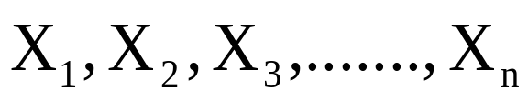



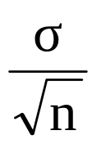
Sampling Distribution of Mean-Normal Population
If are n independent random samples drawn from a Normal Population with Mean = and Standard Deviation = , then the sampling distribution of follows a Normal Distribution with Mean = , and Standard Deviation = .
is known by the term Standard Error.
P.K.Viswanathan

Slide 6
Central Limit Theorem
The distinguishing and unique feature of the central limit theorem is that irrespective of the shape of the distribution of the original population, the sampling distribution of the mean will approach a normal distribution as the size of the sample increases and becomes large.
P.K.Viswanathan

Slide 7
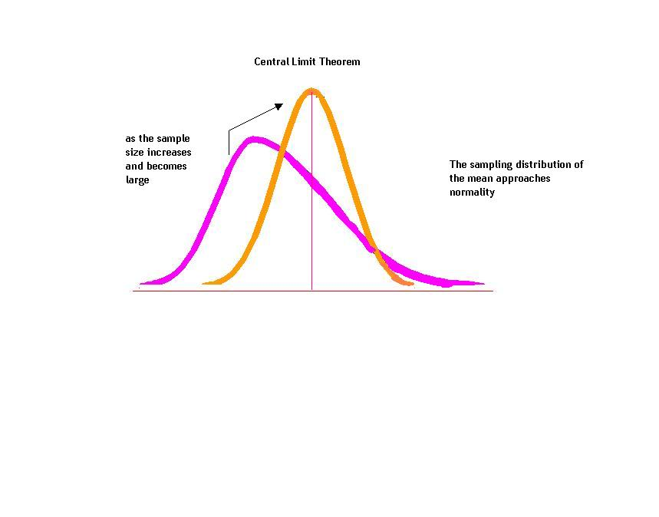
Central Limit Theorem-Picture
P.K.Viswanathan

Slide 8
Hypothesis-Basics
P.K.Viswanathan

Slide 9
What is a Statistical Hypothesis?
A statistical hypothesis is a statement about a population parameter. It may or may not be true. The manager has to ascertain the truth of the hypothesis.
P.K.Viswanathan

Slide 10
Null and Alternative Hypothesis
A Null Hypothesis is status quo. It is so formulated that its rejection leads to the desired conclusion which is the Alternative Hypothesis.
Researchers and Decision Makers generally want to prove the Alternative Hypothesis
P.K.Viswanathan

Slide 11
Type I and Type II Error
Null Hypothesis
True False
Reject Type I No
Error Error
(α )
Accept No Type II Error Error (β)
P.K.Viswanathan

Slide 12
Hypothesis Testing –Marketing Examples from Parasuraman
P.K.Viswanathan

Slide 13
Launching a Product Line Into a New Market Area
Karen, product manager for a line of apparel, to introduce the product line into a new market area
Survey of a random sample of 400 households in that market showed a mean income per household of $30,000. Standard deviation of the population based on a pilot study is $8,000.
Karen strongly believes the product line will be adequately profitable only in markets where the mean household income is greater than $29,000. Should Karen introduce the productline into the new market?
P.K.Viswanathan

Slide 14
Karen’s Criterion for Decision Making
To reach a final decision, Karen has to make a general inference (about the population) from the sample data
Criterion-- mean income across across all households in the market area under consideration
If the mean population household income is greater than $29,000, Karen should introduce the product line into the new market
P.K.Viswanathan

Slide 15
Karen’s Hypothesis
Karen’s decision making is equivalent to either accepting or rejecting the hypothesis:
  The population mean household income in the new market area is greater than $29,000
P.K.Viswanathan

Slide 16
One-Tailed Hypothesis Test
The term one-tailed signifies that all - or z-values that would cause Karen to reject H₀, are in just one tail of the sampling distribution
  μ = Population Mean
  H₀: μ ≤ $29,000
  H_{a}: μ > $29,000
P.K.Viswanathan

Slide 17
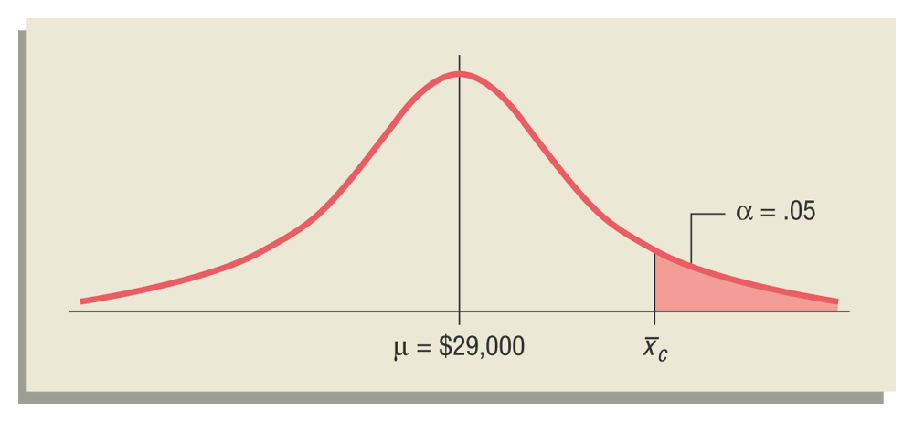
Identifying the Critical Sample Mean Value-- Sampling Distribution
P.K.Viswanathan

Slide 18
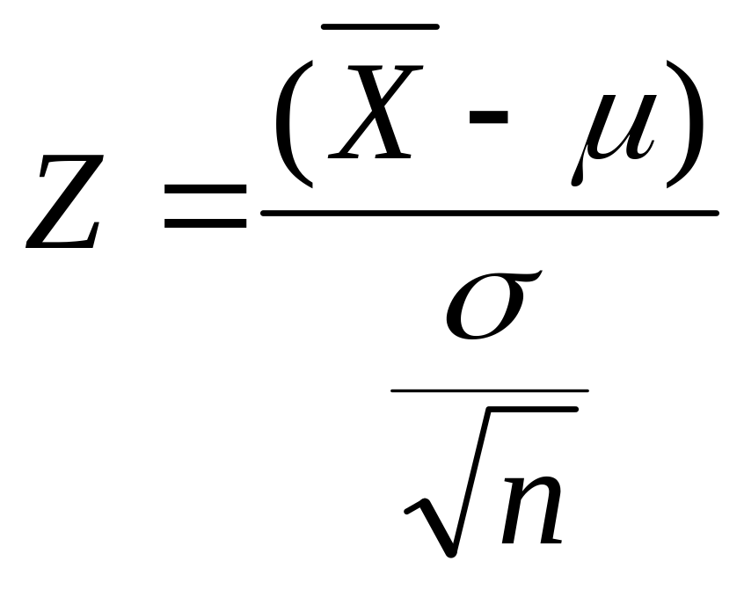
Test Statistic
Substituting the values in the formula given below for the unknown terms, we get Z =2.5.
P.K.Viswanathan

Slide 19
Karen’s Decision Rule
Since the computed Z value falls in the rejection region, reject the null hypothesis and introduce the productline into the new market area.
P.K.Viswanathan

Slide 20
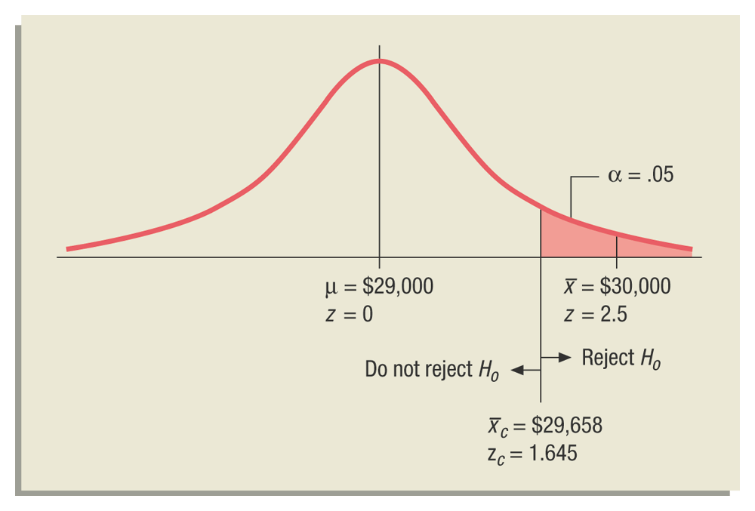
Critical Value for Rejecting the Null Hypothesis
P.K.Viswanathan

Slide 21
P - Value – Actual Significance Level
The probability of obtaining an Z value which is greater than Z computed (and in this case Z computed is 2.5) = .0062.
This value is sometimes called the actual significance level, or the p-value. This is the level at which the null hypothesis gets rejected.
The actual significance level of .0062 in this case means the odds are less than 62 out of 10,000 that the sample mean income of $30,000 would have occurred entirely due to chance (when the population mean income is $29,000 or less).
Since P-Value is less than alpha the level of singnificance(5%), the null hypothesis is rejected. The decision is to introduce the productline ito the new market area.
P.K.Viswanathan

Slide 22
Hypothesis Testing-Inline Question
A retailer is weighing strawberries to sell as 250g punnets. A customer has complained that strawberries he had bought previously weighed under 250g. The retailer decides to check the weight of 36 punnets. He finds that the average weight is 248.5g. with standard deviation 4.8g. In using a significance test to judge whether he is selling under-weight punnets, which of the following conclusions is correct?
a. At 5% level he is selling under weight
b. At 5% level he is not selling under weight
c. At 5% level the test is inconclusive
d. A significance test is inappropriate in this case

Slide 23
Hypothesis Formulation Exercises
State the Null and Alternative Hypothesis for the following:
a) Is the average waiting time for the customers of Smart Supermarket
at the checkouts greater than 15 minutes?
b) Is the proportion of households owning Color TVs in Chennai less than 0.4?
c) Is the average expenditure per household on eating out significantly higher in Bangalore than in Calcutta?
d) Two random sample surveys, conducted with two months gap between the two, assessed public opinions on the outcome: The question that was posed was “If the general election was going to take place tomorrow, would you cast your vote for or against the ruling party?”

Slide 24
t Test Application-One Sample
Experian Marketing Services reported that the typical American spends a mean of 144 minutes (2.4 hours) per day accessing the Internet via a mobile device. (Source: The 2014 Digital Marketer, available at ex.pn/1kXJjfX.) In order to test the validity of this statement, you select a sample of 30 friends and family. The results for the time spent per day accessing the Internet via mobile device (in minutes) are stored in InternetMobileTime .
a. Is there evidence that the population mean time spent per day accessing the Internet via mobile device is different from 144 minutes? Use the p-value approach and a level of significance of 0.05.
b. What assumption about the population distribution is needed in order to conduct the t test in (a)?
Problem 9.35 from the Textbook adapted for Classroom Discussion(Chapter 9-page 314)

Slide 25
Independent t Test-Two Sample
A hotel manager looks to enhance the initial impressions that hotel guests have when they check in. Contributing to initial impressions is the time it takes to deliver a guest’s luggage to the room after check-in. A random sample of 20 deliveries on a particular day were selected in Wing A of the hotel, and a random sample of 20 deliveries were selected in Wing B. The results are stored in Luggage . Analyze the data and determine whether there is a difference between the mean delivery times in the two wings of the hotel. (Use a = 0.05.)
Problem 10.83 from the Textbook adapted for Classroom Discussion(Chapter 10-page 387)

Slide 26
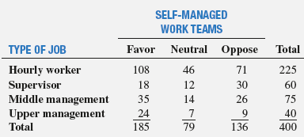
Chi-Square- Application
A company is considering an organizational change involving the use of self-managed work teams. To assess the attitudes of employees of the company toward this change, a sample of 400 employees is selected and asked whether they favor the institution of self-managed work teams in the organization. Three responses are permitted: favor, neutral, or oppose. The results of the survey, cross-classified by type of job and attitude toward self managed work teams, are summarized as follows:
At the 0.05 level of significance, is there evidence of a relationship between attitude toward self-managed work teams and type of job?
Problem 11.32, Chapter 11, Pages 424-425 of the Textbook

